Slide 1
Project Update
Xitong Yang
July 23

Slide 2
Progress
Time check
Experiments
Paper’s tricky parts
Different reference image for different image set
Parameters may differ too
Image cropping

Slide 3
Time check
Time (seconds) | Bookshelf_1 | Bookshelf_2 | Building_1 | Building_2 | Portrait_1 | Portrait_2
size | 2456*1850 | 1280*720 | 1520*901 | 2612*1421 | 1600*1200 | 4752*3168
Homography Flow | 552 | 53 | 114 | 257 | 115 | 1425
Consistent Pixel | 55 | 11 | 16 | 42 | 23 | 169
Temporal Fusion | 168 | 32 | 50 | 130 | 70 | 538
Multi-scale Fusion | 45 | 40 | 41 | 90 | 19 | 137
Total | 820 (13+mins) | 136 | 221 | 519 | 227 | 2269 (38mins)

Slide 4
Consistent Pixel

Slide 5
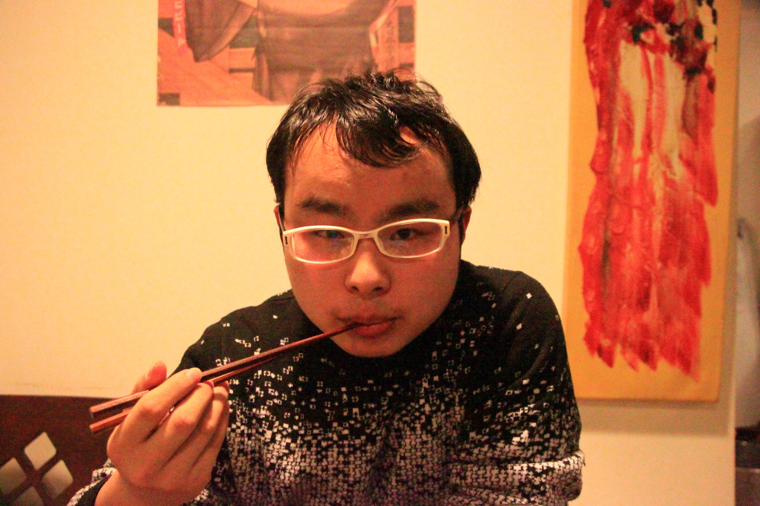
Reference

Slide 6

Our result

Slide 7
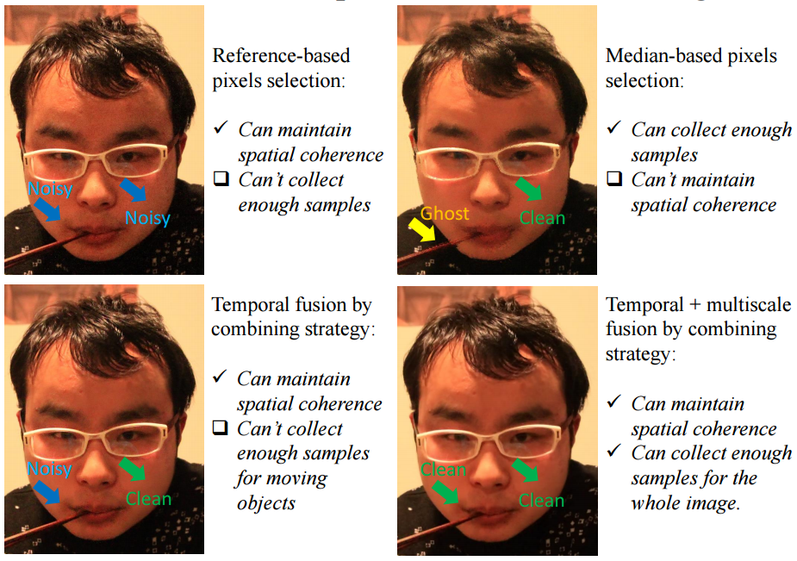
Paper’s

Slide 8
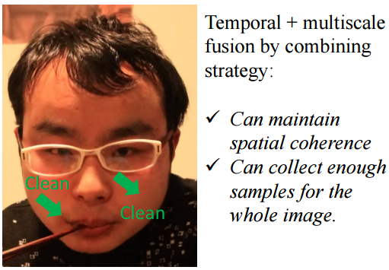
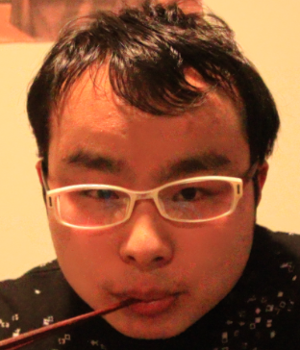
Comparison

Slide 9
Teaser

Slide 10
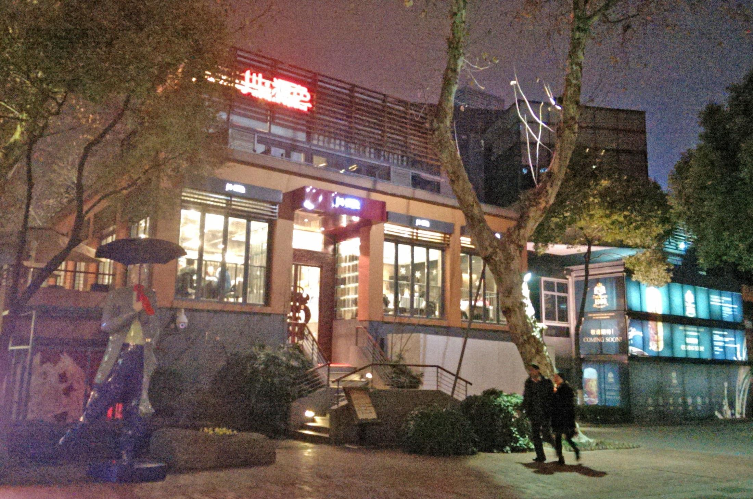
Reference

Slide 11
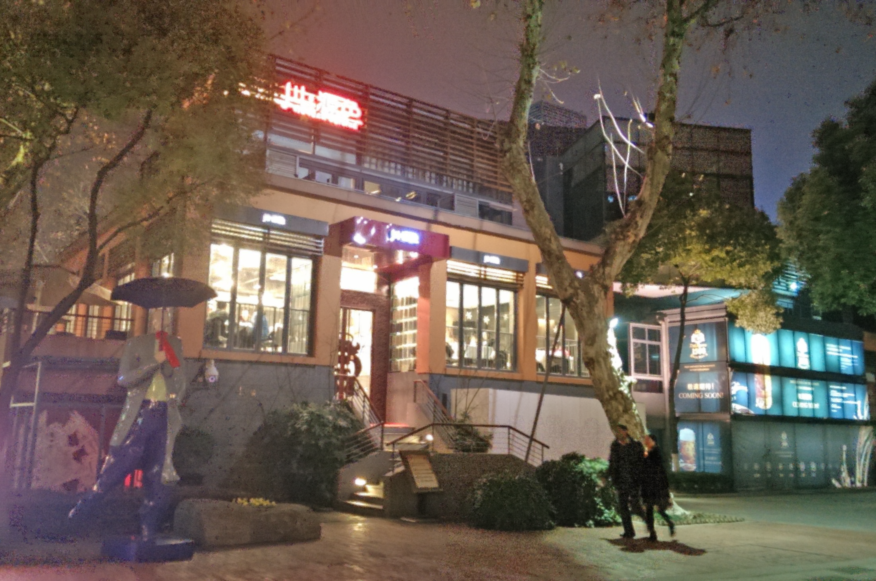
Our result

Slide 12
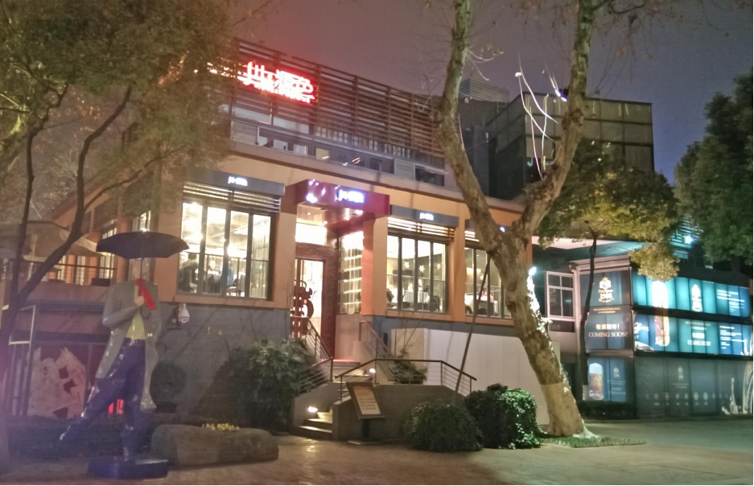
Paper’s

Slide 13
Static Scene

Slide 14
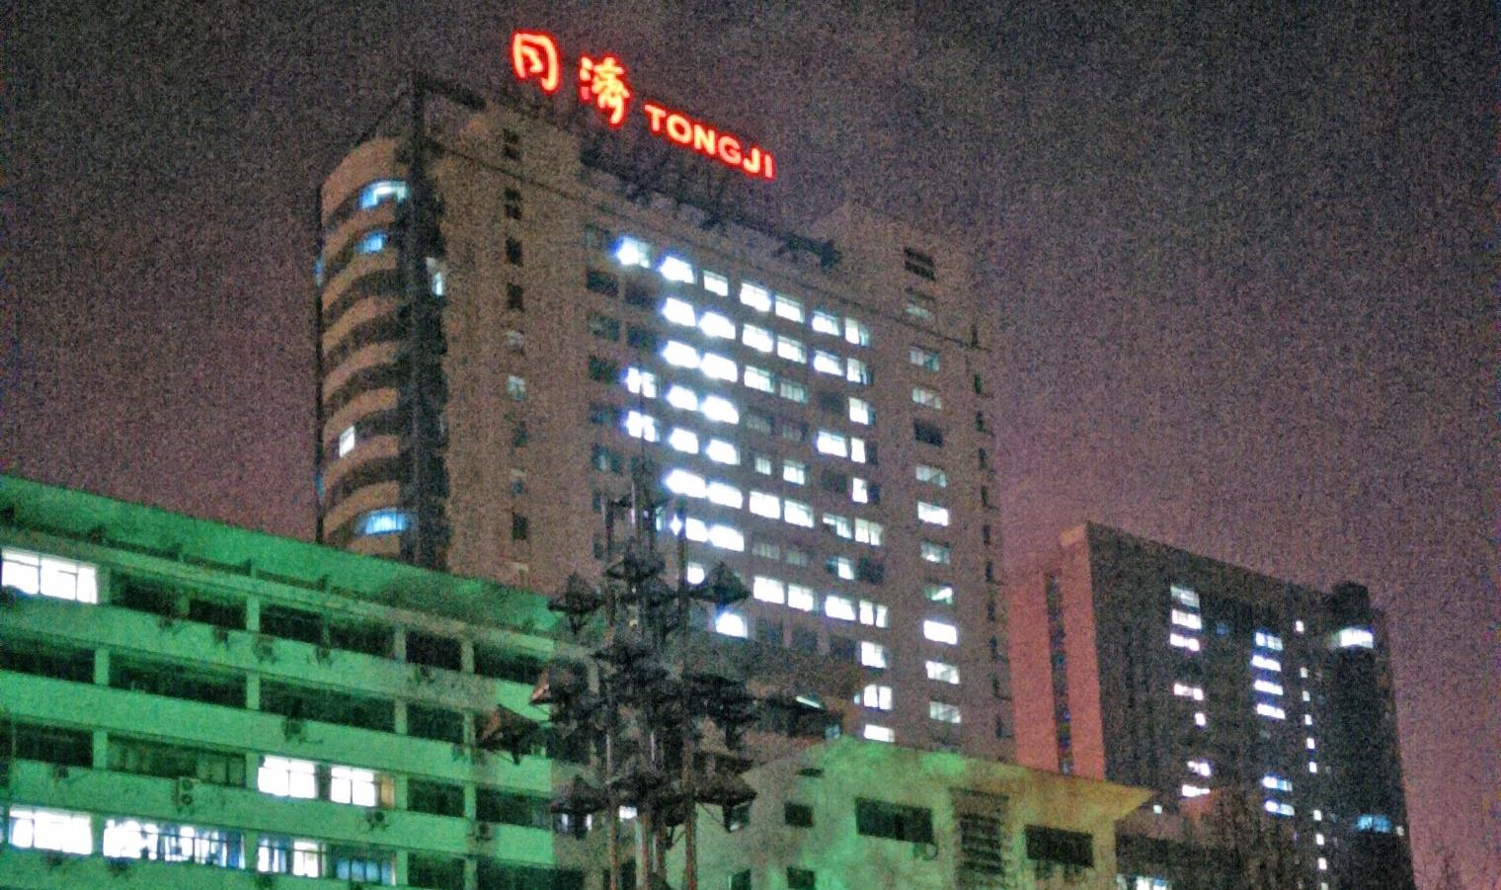
Reference

Slide 15
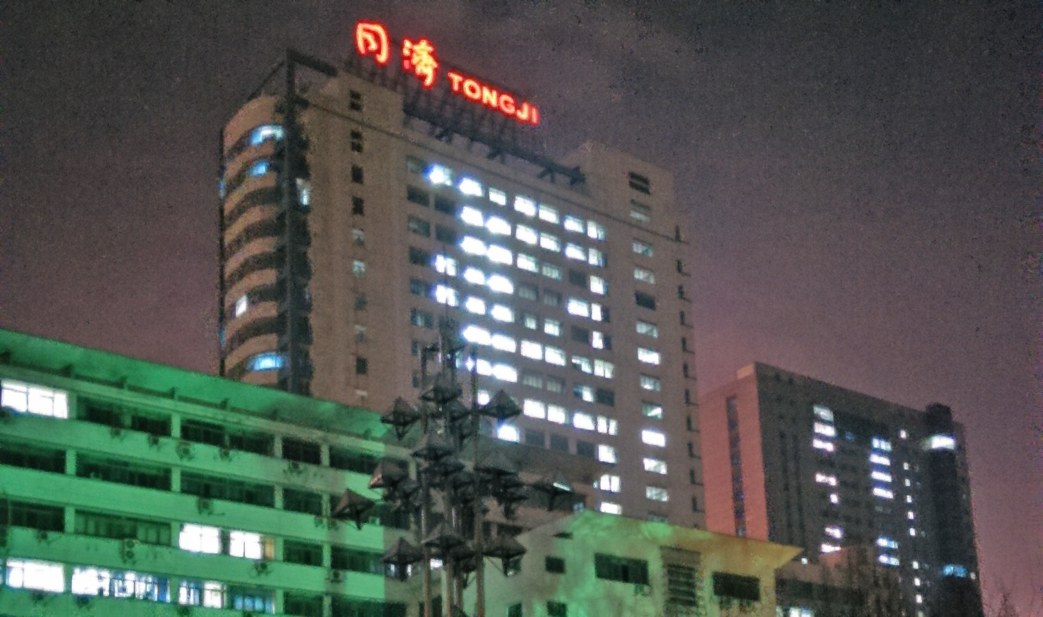
Our result

Slide 16
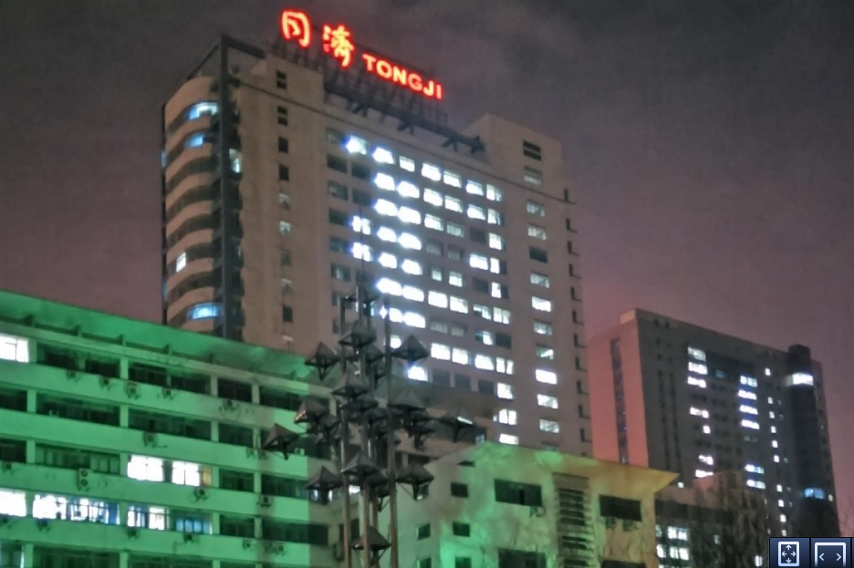
Paper’s

Slide 17
Portrait with small motion

Slide 18
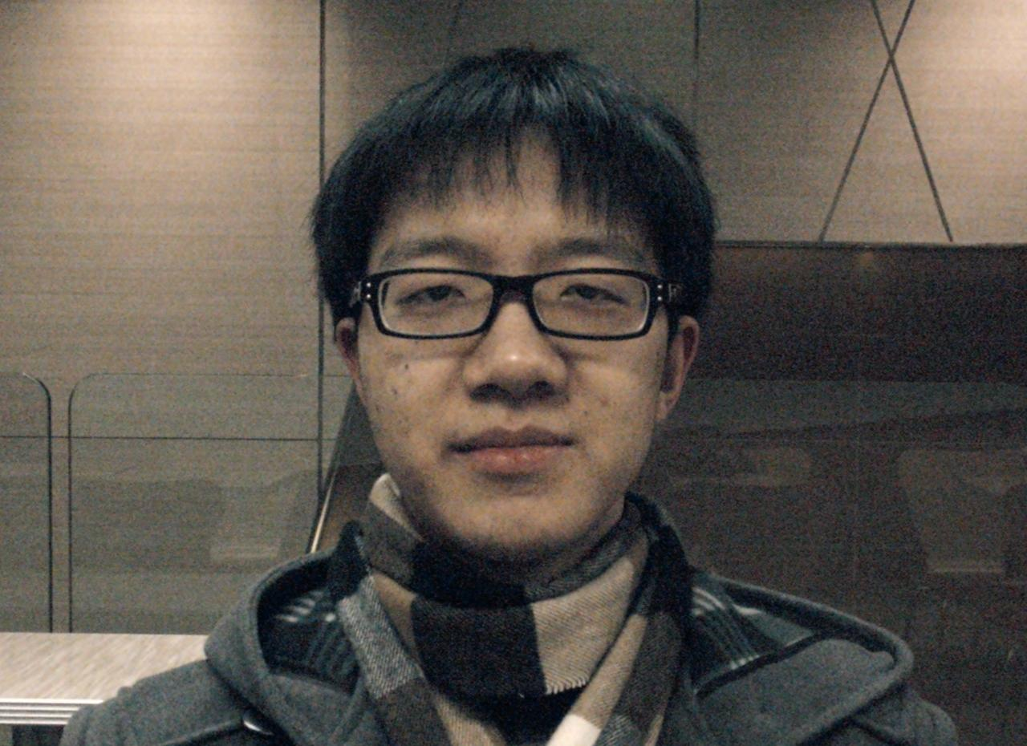
Reference

Slide 19
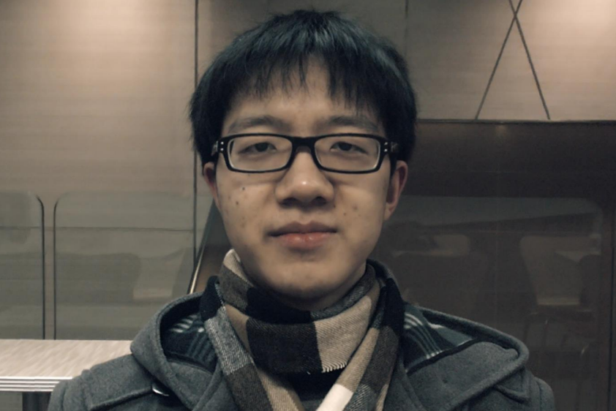
Paper’s

Slide 20

Our result

Slide 21

Tunning

Slide 22
Complex scene motion

Slide 23
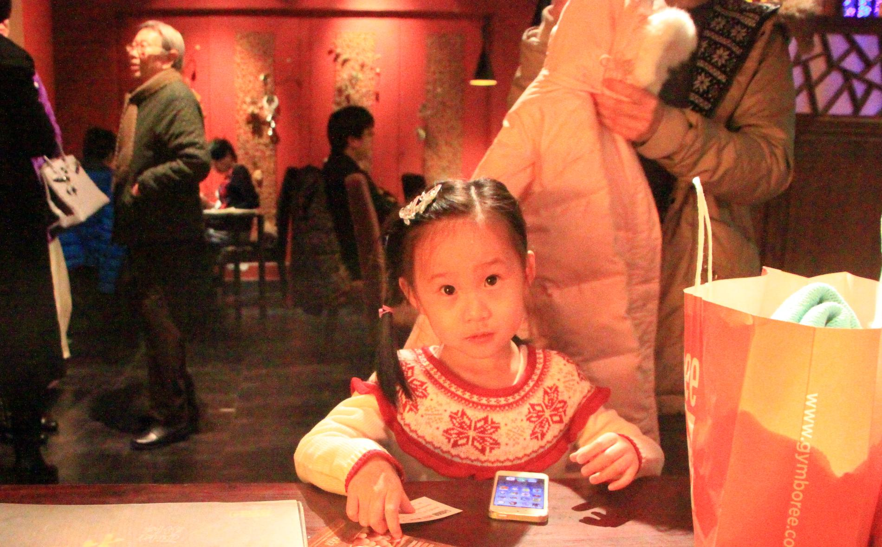
Reference

Slide 24

Our result

Slide 25
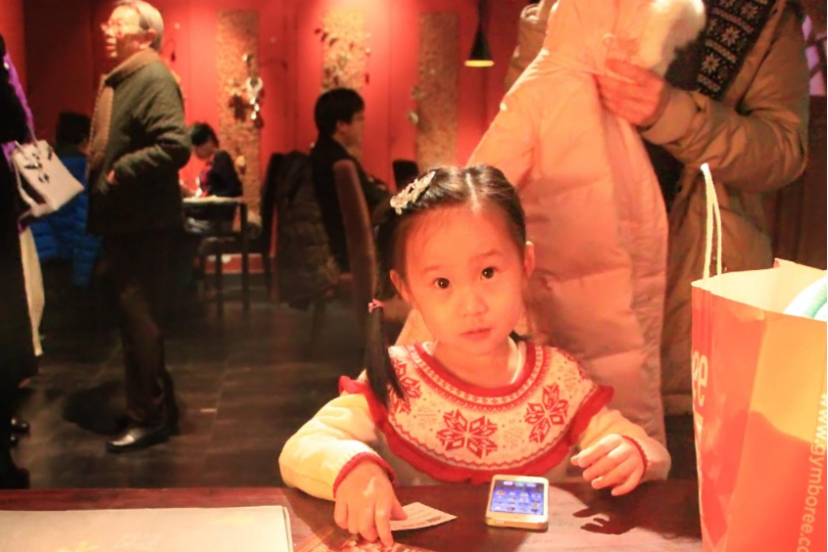
Paper’s

Slide 26
Handling motion blur

Slide 27
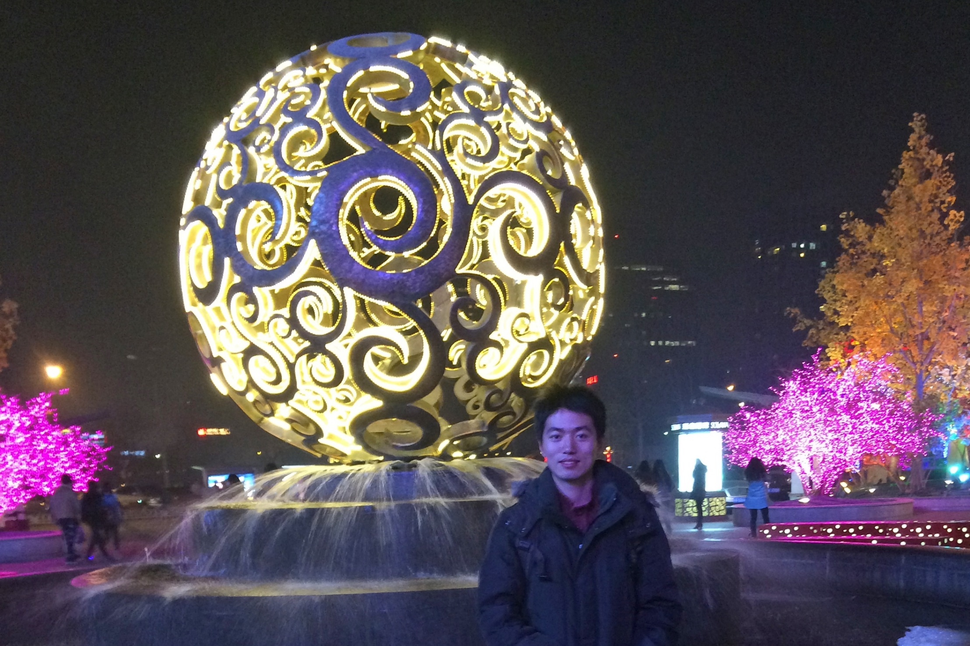
Reference

Slide 28

Our result

Slide 29
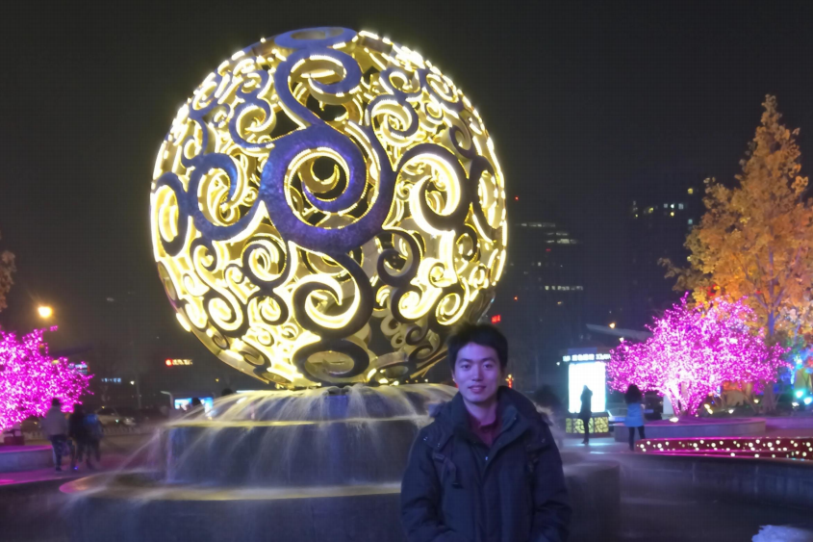
Paper’s

Slide 30
Other results

Slide 31
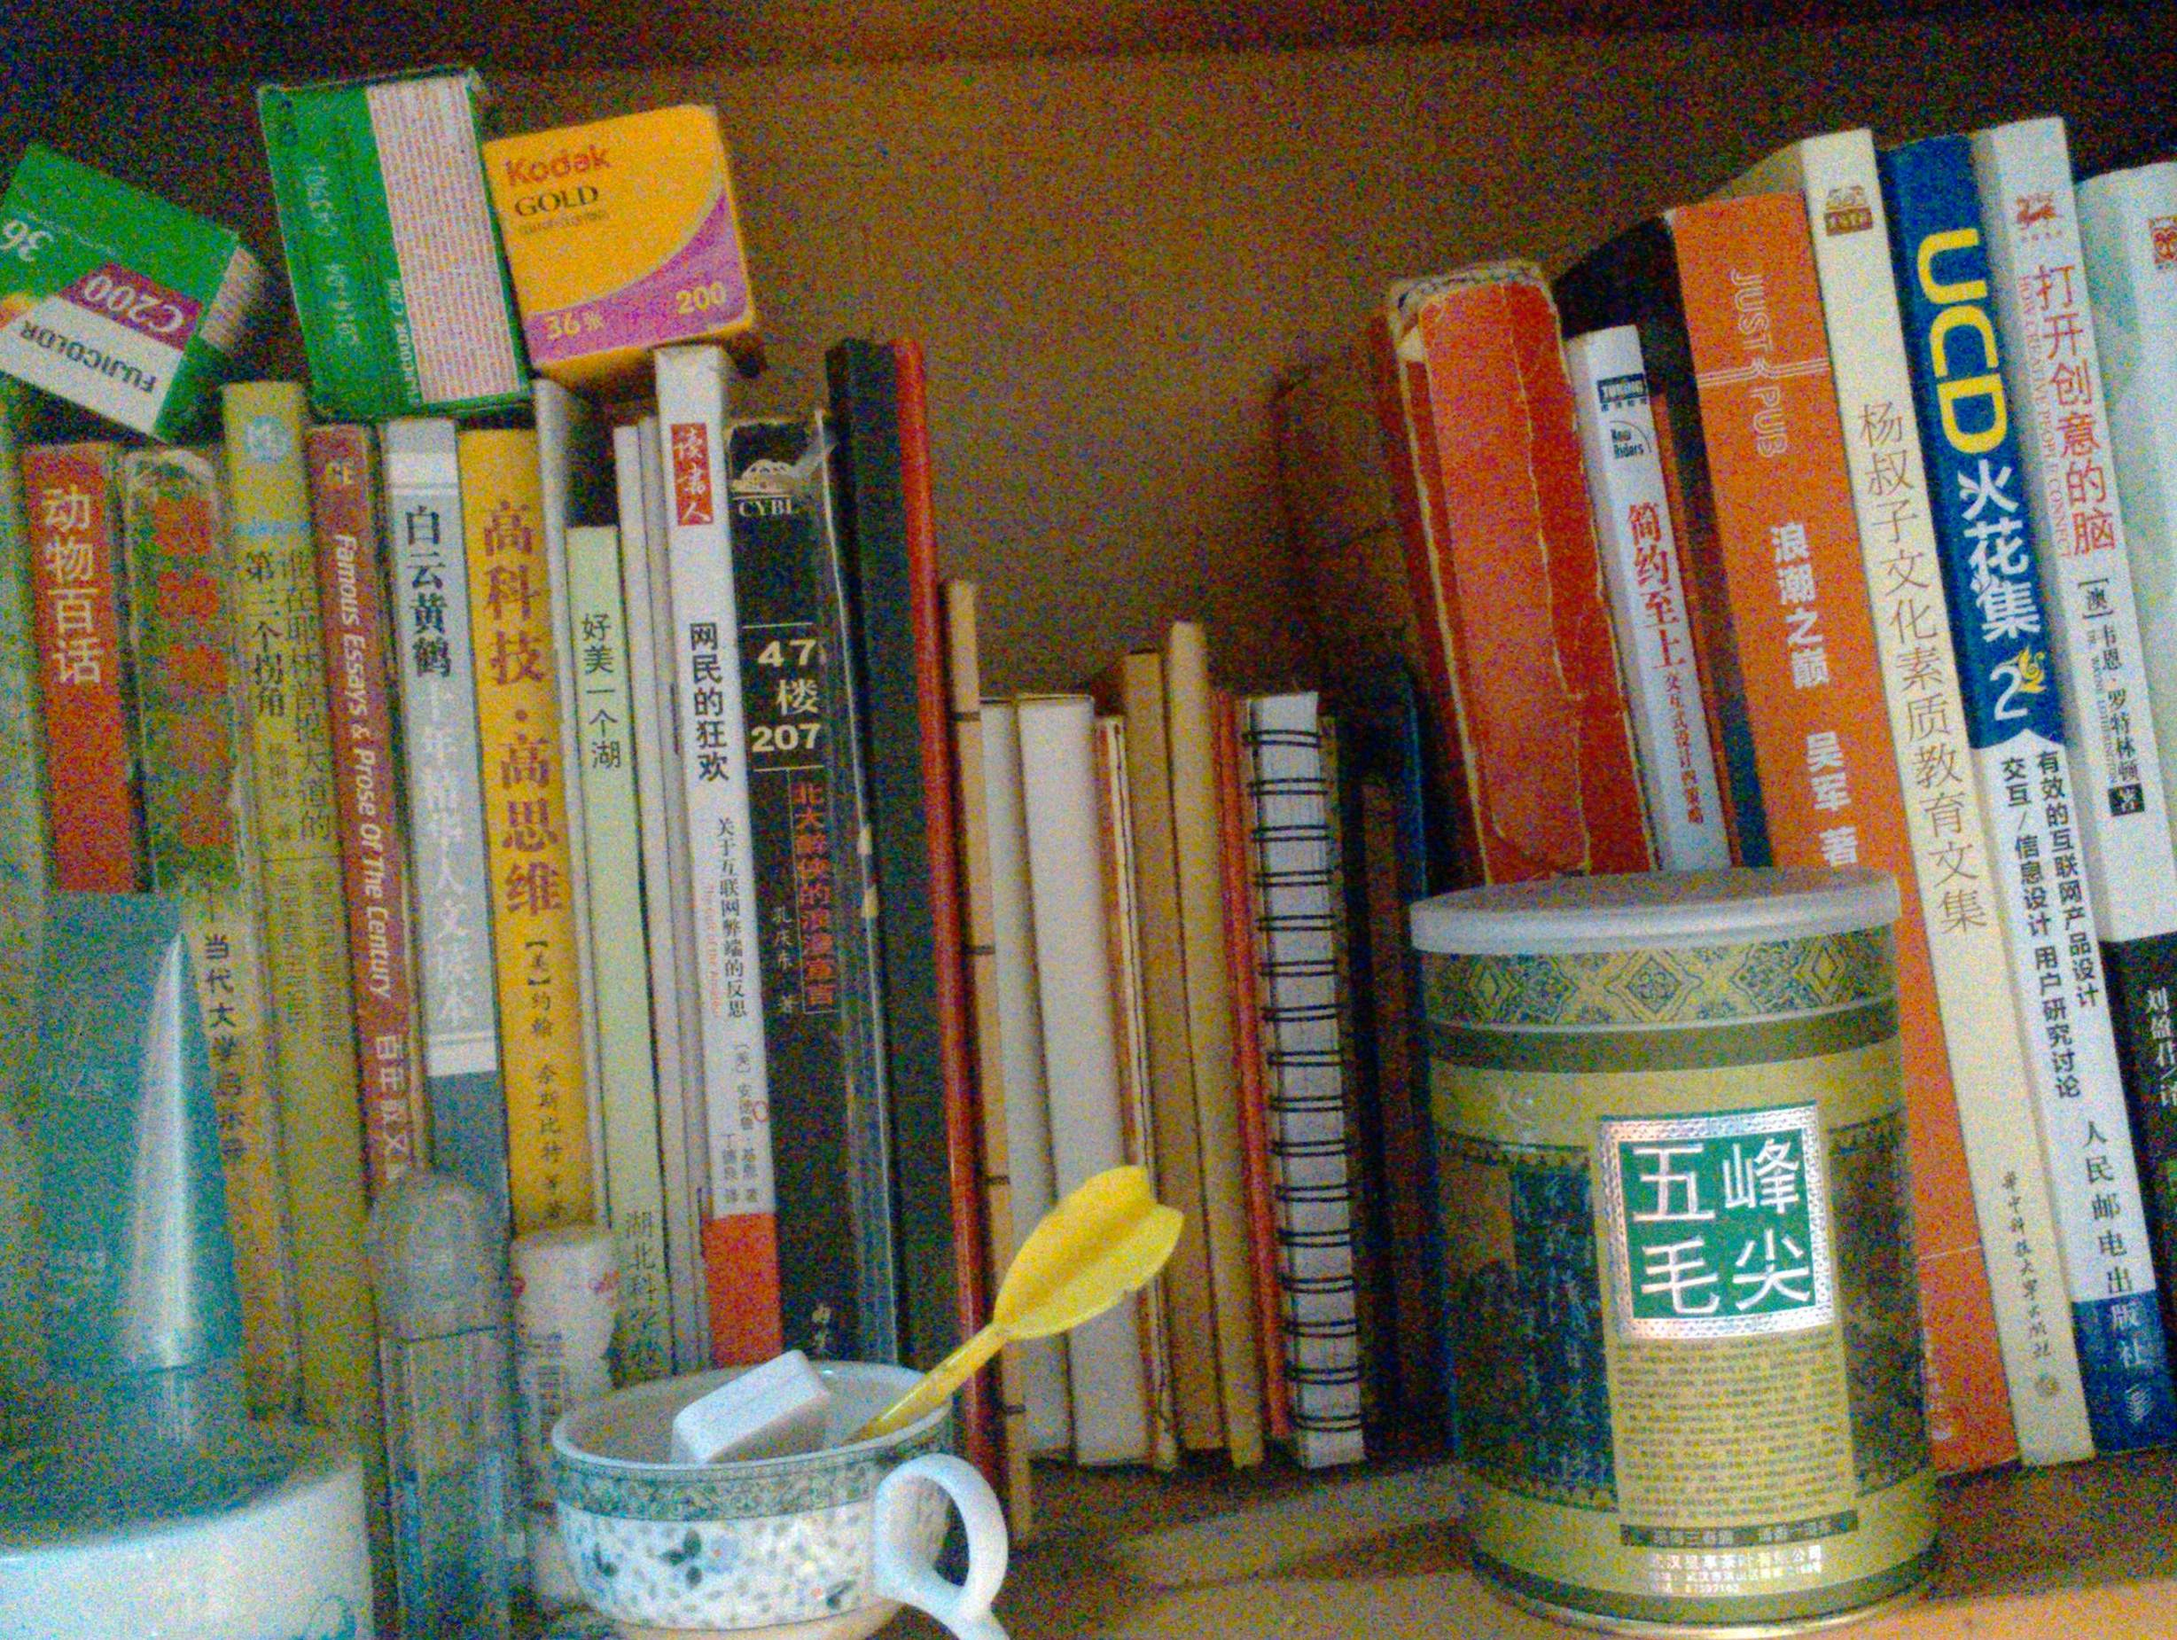
Reference

Slide 32
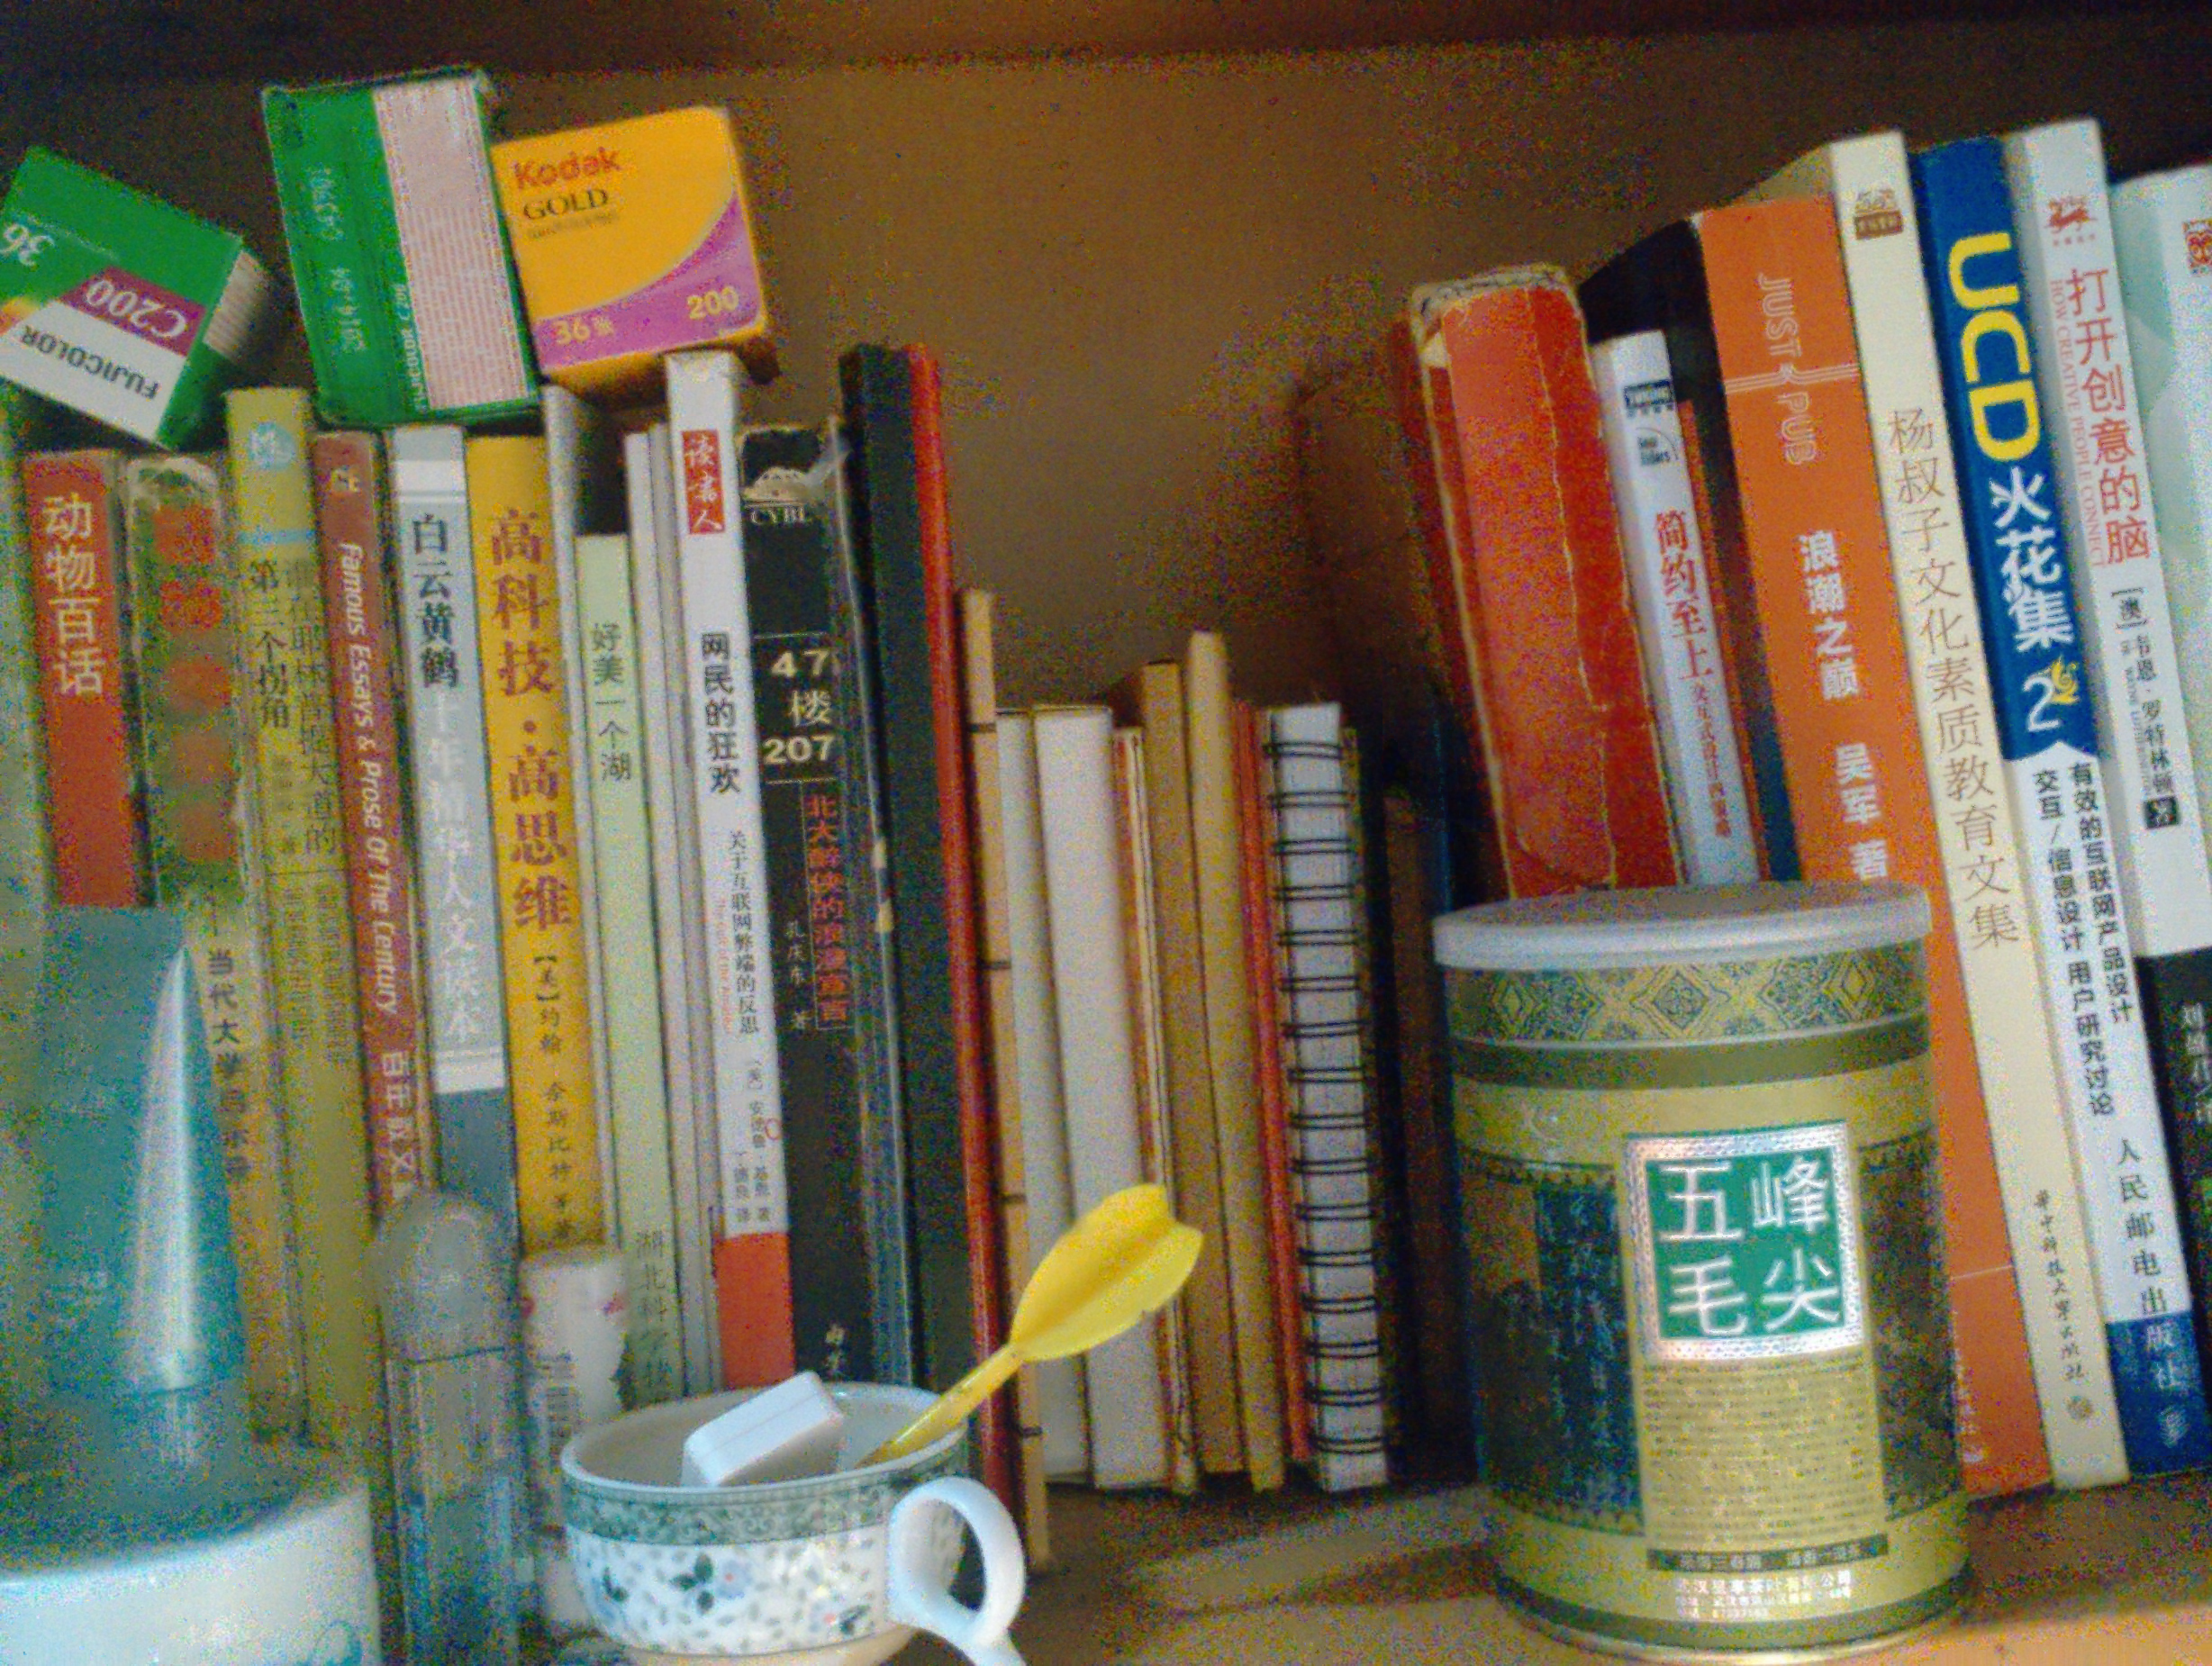
Our result

Slide 33
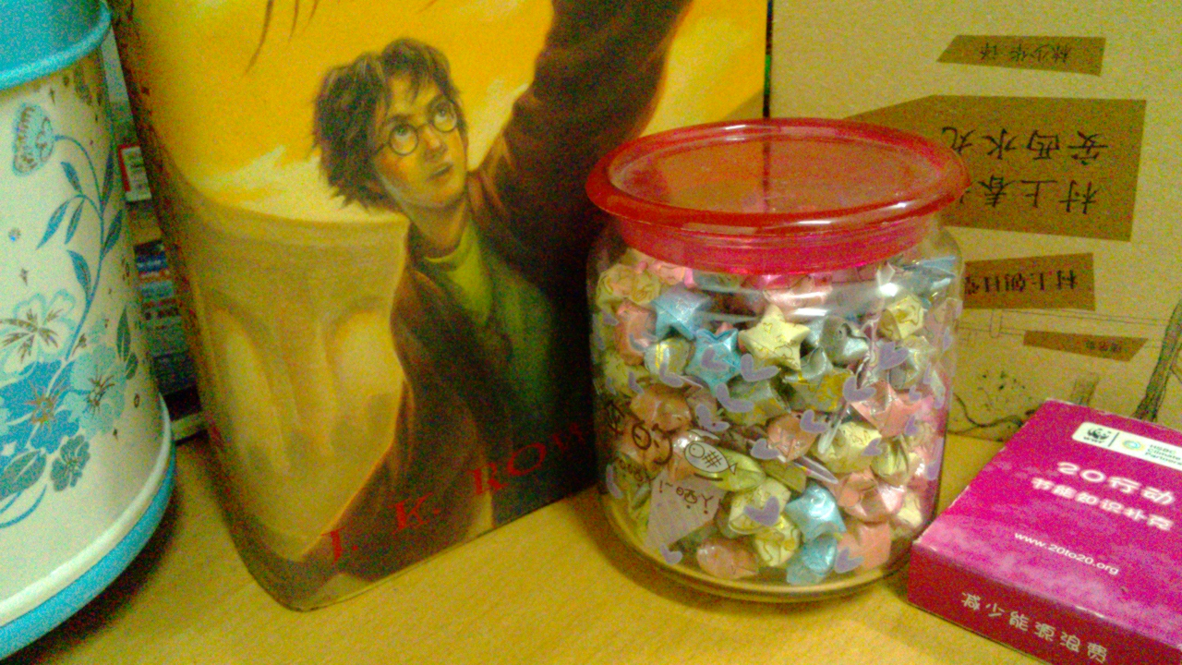
Reference

Slide 34

Our result

Slide 35
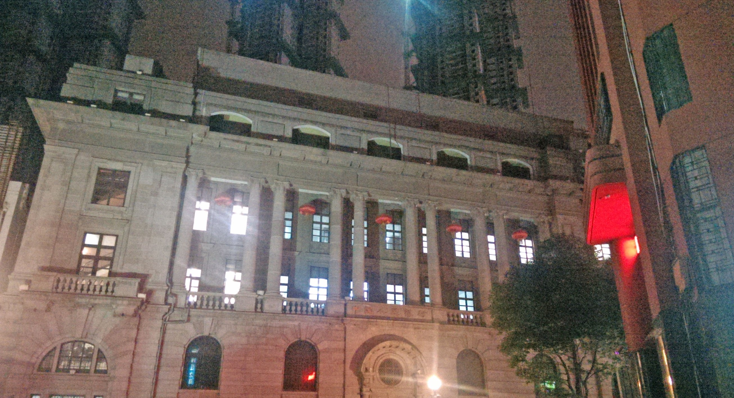
Reference

Slide 36
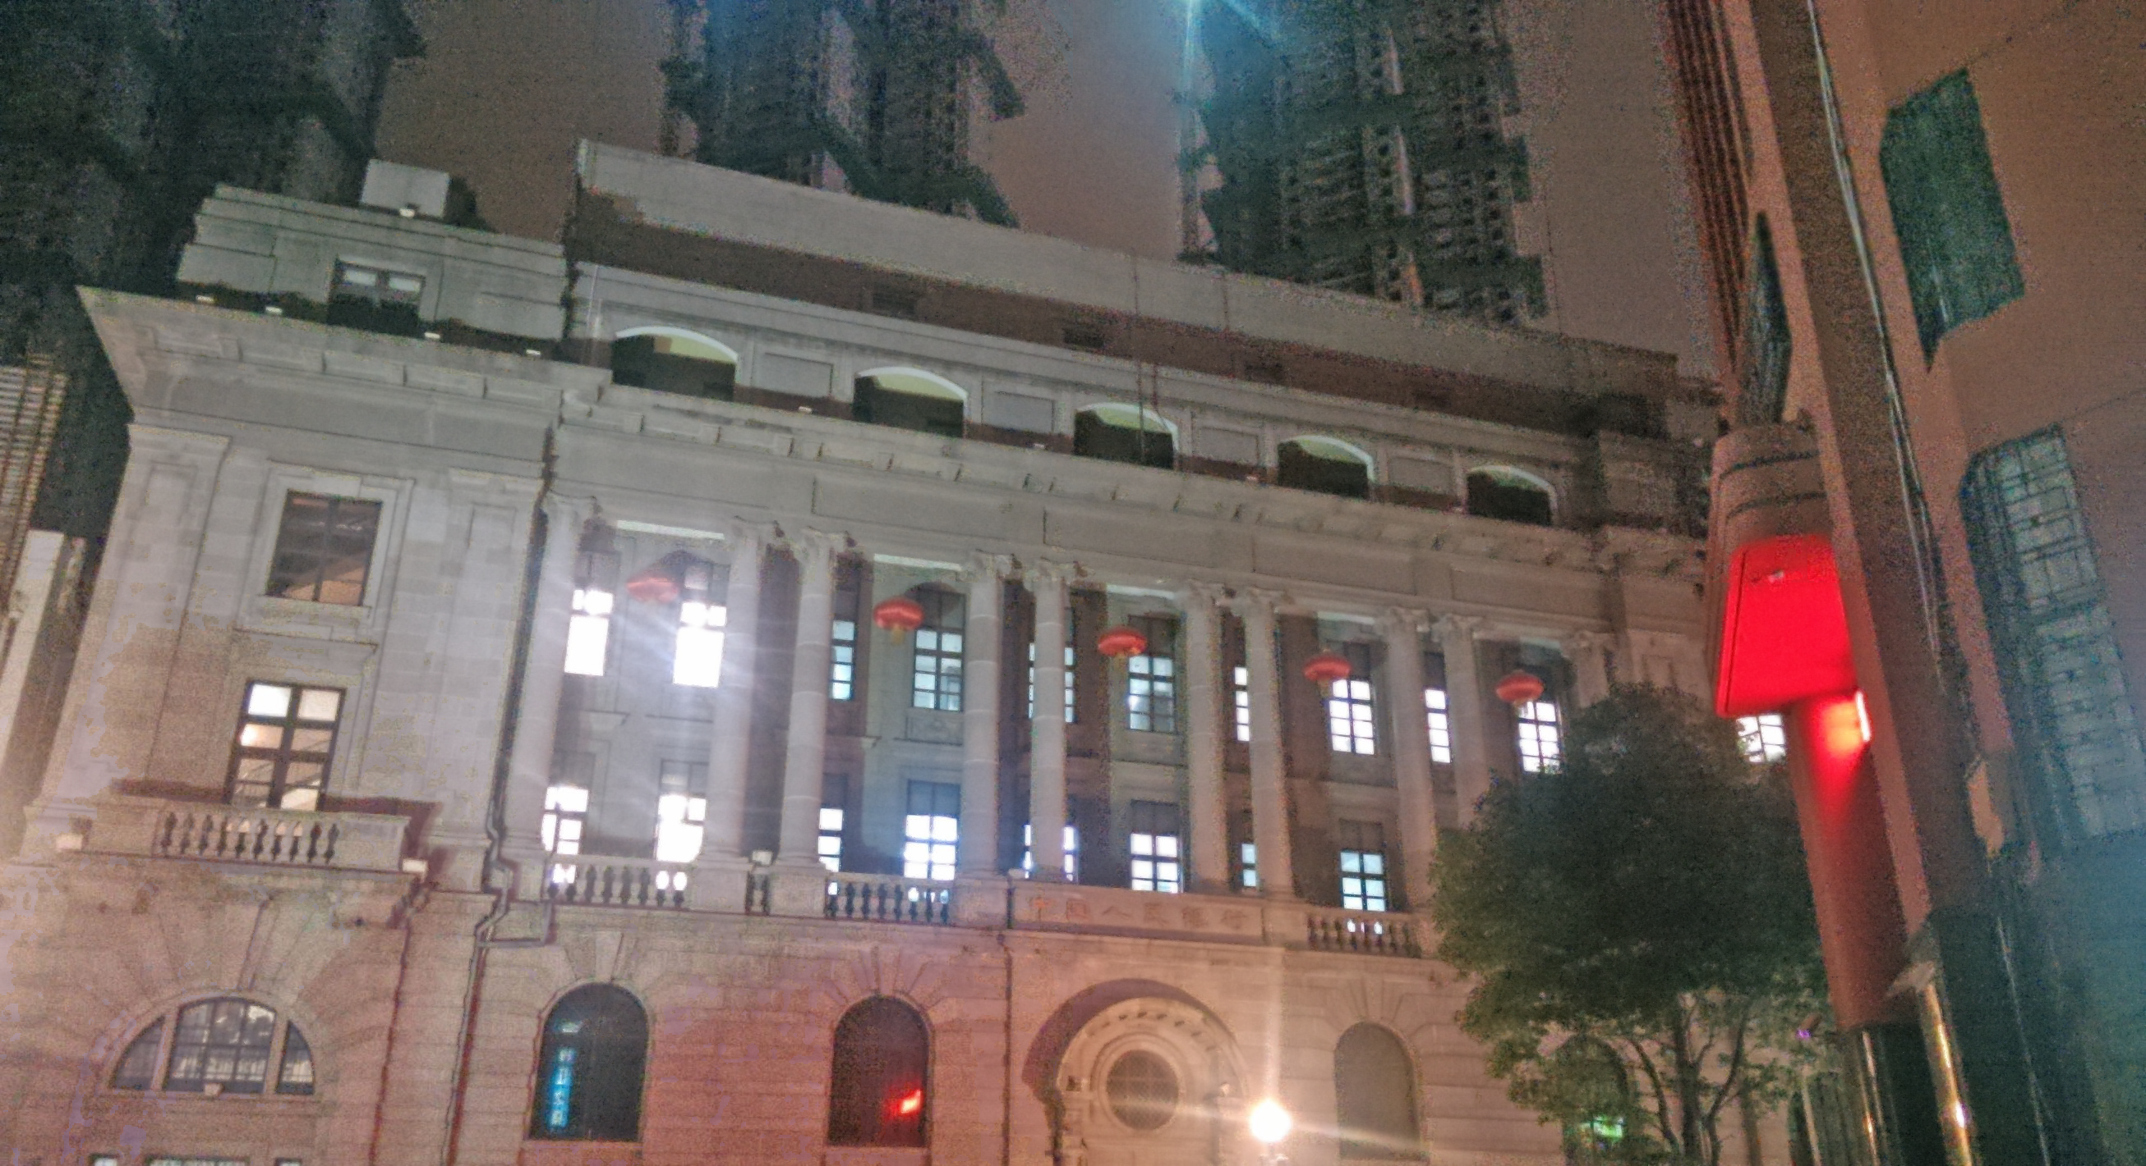
Our result

Slide 37
Next step
Wait for author’s reply about the confusing part
Tune the parameters
More implementation details

